Slide 1





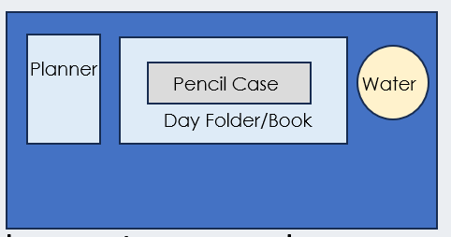

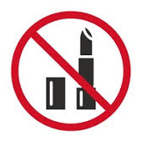

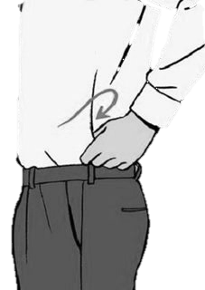


After the register, I am checking your….
Desk
Uniform
SLANT
All subject books go into your bag
(not floor or shelf!)
Notes:
This is you setting your expectation – issue demerits for uniform/equipment if they do not meet your expectation after this.

Slide 2
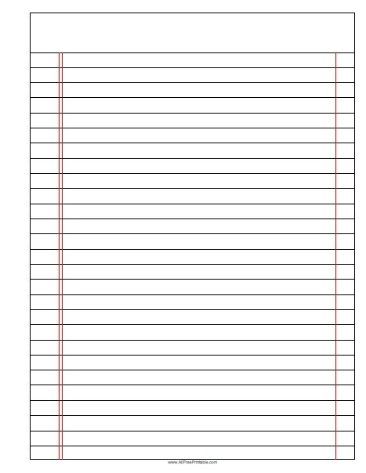






Read Now
Wednesday, 28 January 2026
Percentage by Mass
Task:
Complete the Read Now by:
Stick in the sheet.
Using a highlighter as you read to identify key terms.
Answer the first four recall questions under the sheet in your book.
Answer the stretch question
Aim High | Work Together | Be Kind | Lead the Way

Slide 3

Read Now
MARK SCHEME
Protons and neutrons
Boron: 11 Fluorine: 19 Aluminium: 27
Carbon: 12 Oxygen: 16 Chlorine: 35.5
3. Because aluminium has more protons and neutrons in its nucleus than carbon, so it has a greater mass.
4. Electrons have a very small mass compared to protons and neutrons, so their mass is negligible and can be ignored when finding relative atomic mass.
Aim High | Work Together | Be Kind | Lead the Way
Aim High | Work Together | Be Kind | Lead the Way

Slide 4
Daily Review
Follow your teachers instructions:
“When I say go show me a MWB and a MWB Pen”
You will have 10 seconds for each question.
Hold your MWB in the Ready position
“Show me”
You need to score 70% to pass
Subtitle ‘test score’ ?/10
Aim High | Work Together | Be Kind | Lead the Way
Notes:
Teachers remember to input the quiz score

Slide 5
MWB Quiz
What do you call the number of protons in an element?
What is the combined number of protons and neutrons in an element?
What is the term for a low concentration of a solution?
What is a material consisting of two or more different substances that are not chemically combined?
What is the term for a substance that cannot dissolve in solution?

Slide 6
MWB Quiz
What do you call the number of protons in an element? Atomic number
What is the combined number of protons and neutrons in an element? Mass number
What is the term for a low concentration of a solution? Dilute
What is a material consisting of two or more different substances that are not chemically combined? Mixture
What is the term for a substance that cannot dissolve in solution? Insoluble

Slide 7

Following this lesson, students will be able to:
Recall that relative atomic mass can be written as A_{r} and relative formula mass can be written as M_{r.}
Calculate relative atomic mass and relative formula mass.
Calculate the percentage by mass of an element in a compound.
Key Words:
relative atomic mass
relative formula mass
conservation of mass
percentage

Slide 8
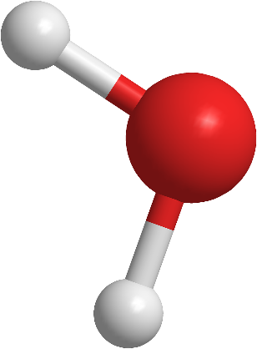
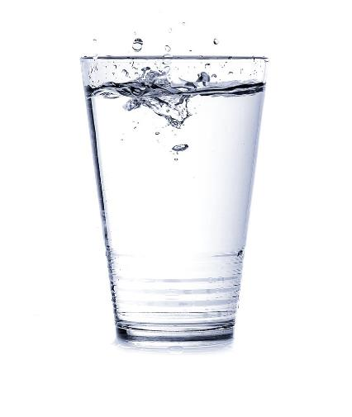
Percentage by mass
H
Water has the chemical formula H₂O.
Think about the mass of a water molecule.
What percentage of that mass do you think comes from hydrogen?
O
H
Notes:
Students will likely guess that 2/3 of the mass is hydrogen because 2/3 of the atoms are hydrogen. This allows you to tackle that misconception immediately.
Suggested script:
Using our knowledge from the last 3 lessons we are now able to complete our first quantitative chemical calculation. We can calculate the exact percentage of a compound’s mass that is provided by one specific element.
As you know, what has the chemical formula H2O. Think about the mass of a water molecule. What percentage of that mass do you think comes from hydrogen?
Here, students might say 66% because water molecules contain 2 atoms of hydrogen and 1 oxygen. The next part of the exposition will be to highlight that the masses of these atoms are very different and so hydrogen only takes up a small percentage of the total mass.
Just knowing the number of atoms of each element in a compound does not tell the full story. Last lesson we learnt that elements do not all have the same mass e.g. hydrogen atoms have much lower mass than oxygen atoms. This means that even though there are fewer oxygen atoms in the water they provide most of the mass overall.
It’s like your school bag. If you have full equipment (you better!) you will have at least 10 things in your pencil case (pens, pencils, glue stick etc). You probably have fewer than 10 books in your bag but because each book is so much bigger than a pen, most of the mass in your bag comes from the books. Similarly, after today’s lesson we will be able to calculate the exact percentage of a compound’s overall mass that is provided by a specific element.
This type of calculation can also be used to help increase our understanding of our own bodies and the world around us e.g. by calculating that on average 65% of your body’s mass is provided by oxygen atoms or that 71% of the mass of the Sun’s outer layers (photosphere and chromosphere) is provided by hydrogen atoms.
​Example for higher sets: E.g. guanine (a substance used to make DNA) has 5 hydrogen atoms, 5 nitrogen atoms and 5 carbon atoms but they do not make up an equal amount of mass.​
Image from pixabay

Slide 9
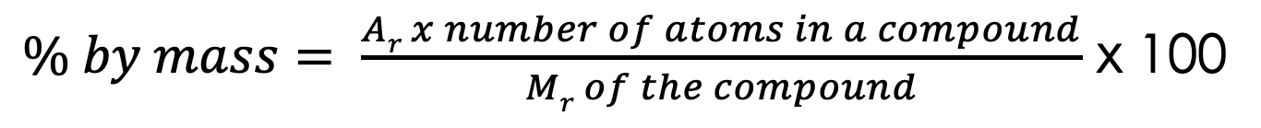
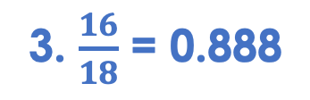
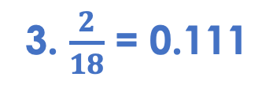
Percentage by mass
Percentage by mass is used to calculate the percentage by mass of an element within a compound
$\% by mass= \frac{Ar x number of atoms in a compound}{Mr of the compound}$ x 100
What is the Percentage by mass of hydrogen in water (H₂O)?
What is the Percentage by mass of oxygen in water (H₂O)?
Steps:
1. Find the A_{r} and count the number of each type of atom.
1. A_{r} of hydrogen = 1
1. A_{r} of oxygen = 16
2. Find the M_{r}
Number of hydrogen atoms = 2
Number of oxygen atoms = 1
3. Divide the sum of the relative atomic masses of all atoms you are investigating by the relative formula mass
2. M_{r} of H₂O =18
2. M_{r} of H₂O =18
3. $\frac{2}{18}$ = 0.111
3. $\frac{16}{18}$ = 0.888
4. 0.111 x 100 = 11.11%
4. Multiply by 100
4. 0.888 x 100 = 88.8%
Notes:
Suggested script:
Percentage by mass is exactly what it sounds like. When you think of a compound, made up of different types of atom, each atom will have a different mass, and those masses added together make up the total mass of the compound. Like water, contains hydrogen atoms and an oxygen atom. Dual code on the board the formula for water and draw a simple molecule with 2 x hydrogen atoms bonded to an oxygen atom in a V shape.
We can use a percentage by mass calculation to figure out what percentage of the total mass comes from a single element or group of atoms. So thinking about water, we can check what percentage of the mass of that compound is hydrogen atoms, and what percentage is the oxygen atom. Is the hydrogen contributing 50% of the mass? 10%? 90% who knows?!
So, read definition, percentage by mass is used to calculate the percentage by mass of an element within a compound.
How can we find this out? Well, we use a formula which looks like this. animate formula.
What is this formula telling us? To calculate the percentage by mass, we should multiply the relative atomic mass of an element by the number of atoms of that element in a compound. Then divide by the relative formula mass of the compound. Then multiple by 100.
Lets look at this in practice. What is the percentage by mass of hydrogen in water, H₂O?
animate to reveal the steps one by one with the worked example.
This can also be called a ‘percentage composition’ calculation.
Repeat this process with the second calculation worked out on the slide.
Repeat on the whiteboard with other simple compounds as necessary for students to grasp this method, and then give students an opportunity to try this independently. You can also ask students to work it out in pairs before trying independently.

Slide 10
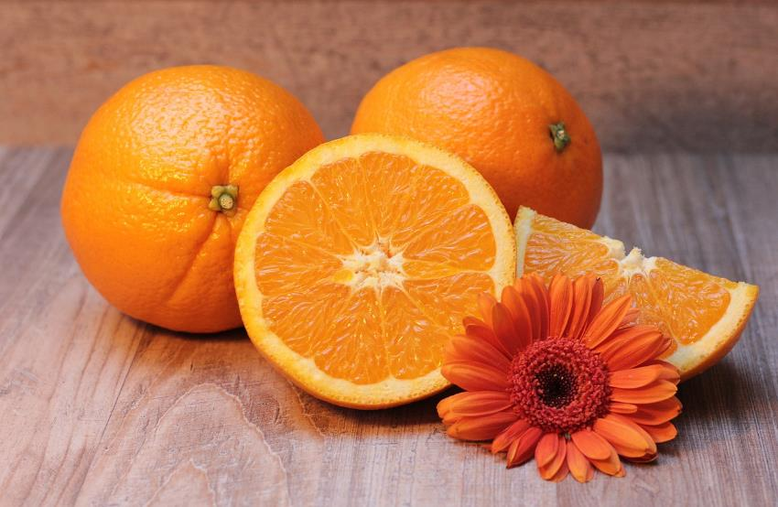
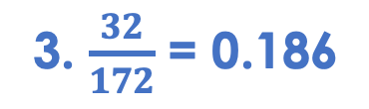
Percentage by mass
The chemical octyl acetate smells like oranges.
It has the formula C₁₀H₂₀O_{2.}
Calculate the percentage by mass of oxygen in octyl acetate.
1. A_{r} of oxygen = 16
Number of oxygen atoms = 2
2. M_{r} of C₁₀H₂₀O₂ = 172
3. $\frac{32}{172}$ = 0.186
4. 0.186 x 100 = 18.6%
Notes:
Image source: Pixabay

Slide 11
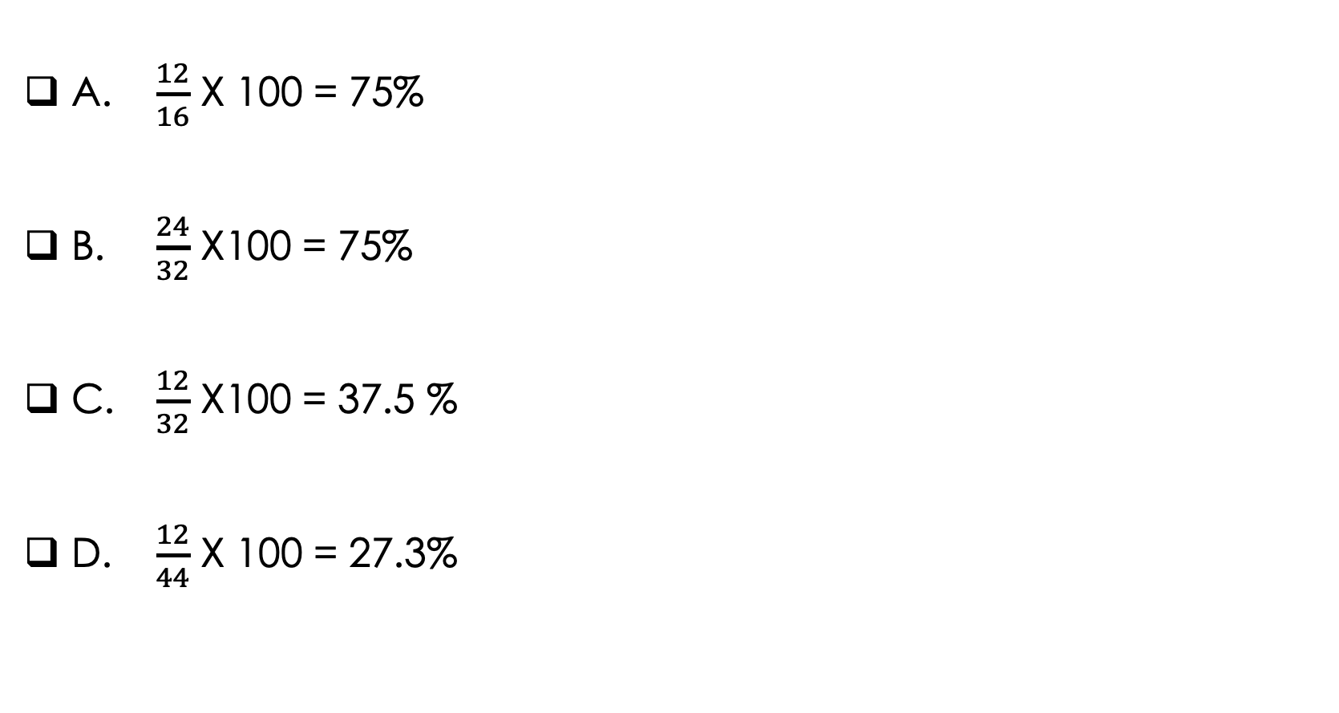
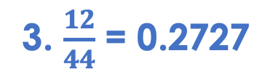
What is the percentage by mass of carbon in CO₂?
A. $\frac{12}{16}$ X 100 = 75%
B. $\frac{24}{32}$ X100 = 75%
C. $\frac{12}{32}$ X100 = 37.5 %
D. $\frac{12}{44}$ X 100 = 27.3%
1. A_{r} of carbon = 12
Number of carbon atoms = 1
2. M_{r} of CO₂ =44
3. $\frac{12}{44}$ = 0.2727
✓
4. 0.2727 x 100 = 27.3%

Slide 12
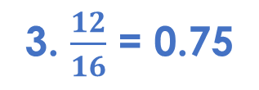
I: Worked example
Calculate the percentage of carbon in CH₄.
(A_{r}: C = 12, H = 1)
1. Use the A_{r} of C
1. A_{r} of carbon = 12
Count the number of carbon atoms
Number of carbon atoms = 1
2. Find the M_{r} of CH₄
2. M_{r} of CH₄ =16
3. Use the equation $\% by mass= \frac{Ar x number of atoms in a compound}{Mr of the compound}$ x 100
3. $\frac{12}{16}$ = 0.75
4. Calculate using a calculator
4. 0.75 x 100 = 75%

Slide 13
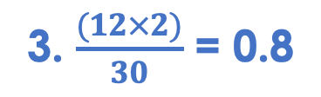
We: Worked example
Calculate the percentage of carbon in C₂H₆.
(A_{r}: C = 12, H = 1)
1. Use the A_{r} of C
1. A_{r} of carbon = 12
Count the number of carbon atoms
Number of carbon atoms = 2
2. Find the M_{r} of C₂H₆
2. M_{r} of C₂H₆ =30
3. Use the equation $\% by mass= \frac{Ar × number of atoms in a compound}{Mr of the compound}$ x 100
3. $\frac{(12×2)}{30}$ = 0.8
4. Calculate using a calculator
4. 0.8 x 100 = 80%

Slide 14
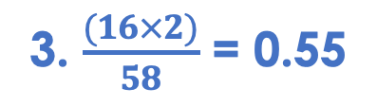
You: Worked example
Calculate the percentage of Oxygen in Mg(OH)₂.
(A_{r}: C = 12, H = 1)
1. Use the A_{r} of C
1. A_{r} of oxygen = 16
Count the number of carbon atoms
Number of oxygen atoms = 2
2. Find the M_{r} of Mg(OH)₂
2. M_{r} of Mg(OH)₂ =58
3. Use the equation $\% by mass= \frac{Ar × number of atoms in a compound}{Mr of the compound}$ x 100
3. $\frac{(16×2)}{58}$ = 0.55
4. Calculate using a calculator
4. 0.55 x 100 = 55%

Slide 15
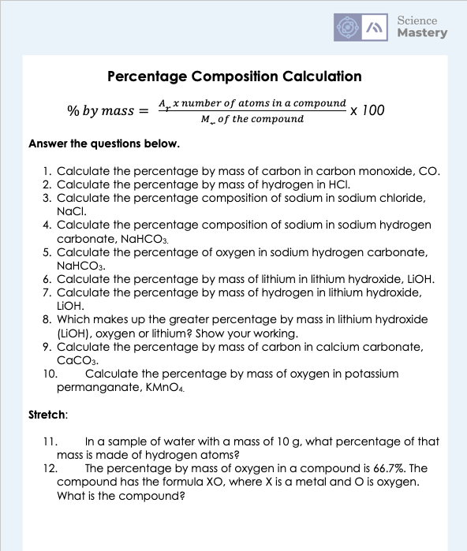
Percentage Composition Calculation worksheet

Slide 16
Answer the questions below.
What is the relative formula mass for NH₃? (A_{r}: N = 14; H = 1)
A. 17
B. 15
C. 45
Calculate the percentage by mass of carbon in C₂H₄.
A. 28%
B. 85.7%
C. 42.8%
Calculate the percentage by mass of carbon in carbon monoxide (CO).
A. 18%
B. 43%
C. 0.43%
✓
✓
✓
Notes:
Q1. Answer: A
If students answer B, they have added together the relative atomic masses, but have not considered the number of each type of atom. If students have answered C, they have taken the subscript ‘3’ to multiple both atoms by 3, instead of just the hydrogen atoms. To fix-it, give students a selection of compounds, and for each one ask them to list the number of each type of atom indicated in the formula. Then they should use this information to calculate the relative formula mass.
Q2. Answer: B
If students answer A, they have calculated the relative formula mass of the compound instead of the percentage by mass as the question states. If the student answers C, they have calculated percentage by mass without taking into account the number of carbon atoms in the formula. To fix-it, model the correct method to work out a percentage by mass calculation, and then give students some more percentage composition calculations to practice.
Q3. Answer: B
If students answer A, they have added together the relative atomic masses of carbon and oxygen instead of using the calculation formula. If students answer C, they have forgotten to multiply by 100 to give an answer as a percentage. To fix-it, model the correct method to work out a percentage by mass calculation, and then give students some more percentage composition calculations to practice.

